Slide 1
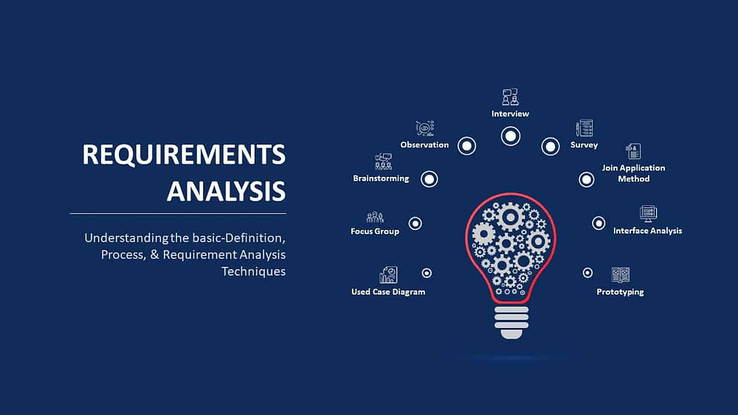
REQUIREMENT ANALYSIS

Slide 2
What Is Requirements Analysis?
Requirements analysis or requirements engineering is a process used to determine the needs and expectations of a new product. It involves frequent communication with the stakeholders and end-users of the product to define expectations, resolve conflicts, and document all the key requirements.
One of the greatest challenges faced by any organization is to share the vision of the final product with the customers. Hence, a business requirements analysis involves a team effort of all the key stakeholders, software developers, end-users, and customer managers to achieve a shared understanding of what the product should do. This is always done in the early phase of any project to ensure that the final product conforms to all the requirements.

Slide 3
Requirement Analysis Tools
Requirements analysis can be performed successfully by using the right set of tools. Here are some of the most popular ones:
Jama Software
Caliber
Visure Requirements
Orcanos
Modern Requirements
IBM Engineering Requirements Management DOORS Next
Accompa
ReqSuite
Perforce Helix RM
Pearls

Slide 4
Requirement Analysis Techniques
1. Business Process Model and Notation (BPMN)
Business Process Model and Notation is used to create graphs that simplify the understanding of the business process. It is a popular technique used by Business analysts to coordinate the sequence of messages between different participants in a related set of activities
.
2. Flowcharts
Flowcharts depict sequential flow and control logic of a related set of activities. They are useful for both technical and non-technical members.
3. Gantt Charts
Gantt Charts provide a visual representation of tasks along with their scheduled timelines. They help business analysts visualize the start and end dates of all the tasks in a project.
4. Gap Analysis
Gap analysis evaluates the gaps in a product’s performance to determine whether the requirements are met or not. They help Business analysts determine the present state and target state of a product.

Slide 5


